Slide 1
Financial Banking: Credit Data
- Ashwini Kondur

Slide 2
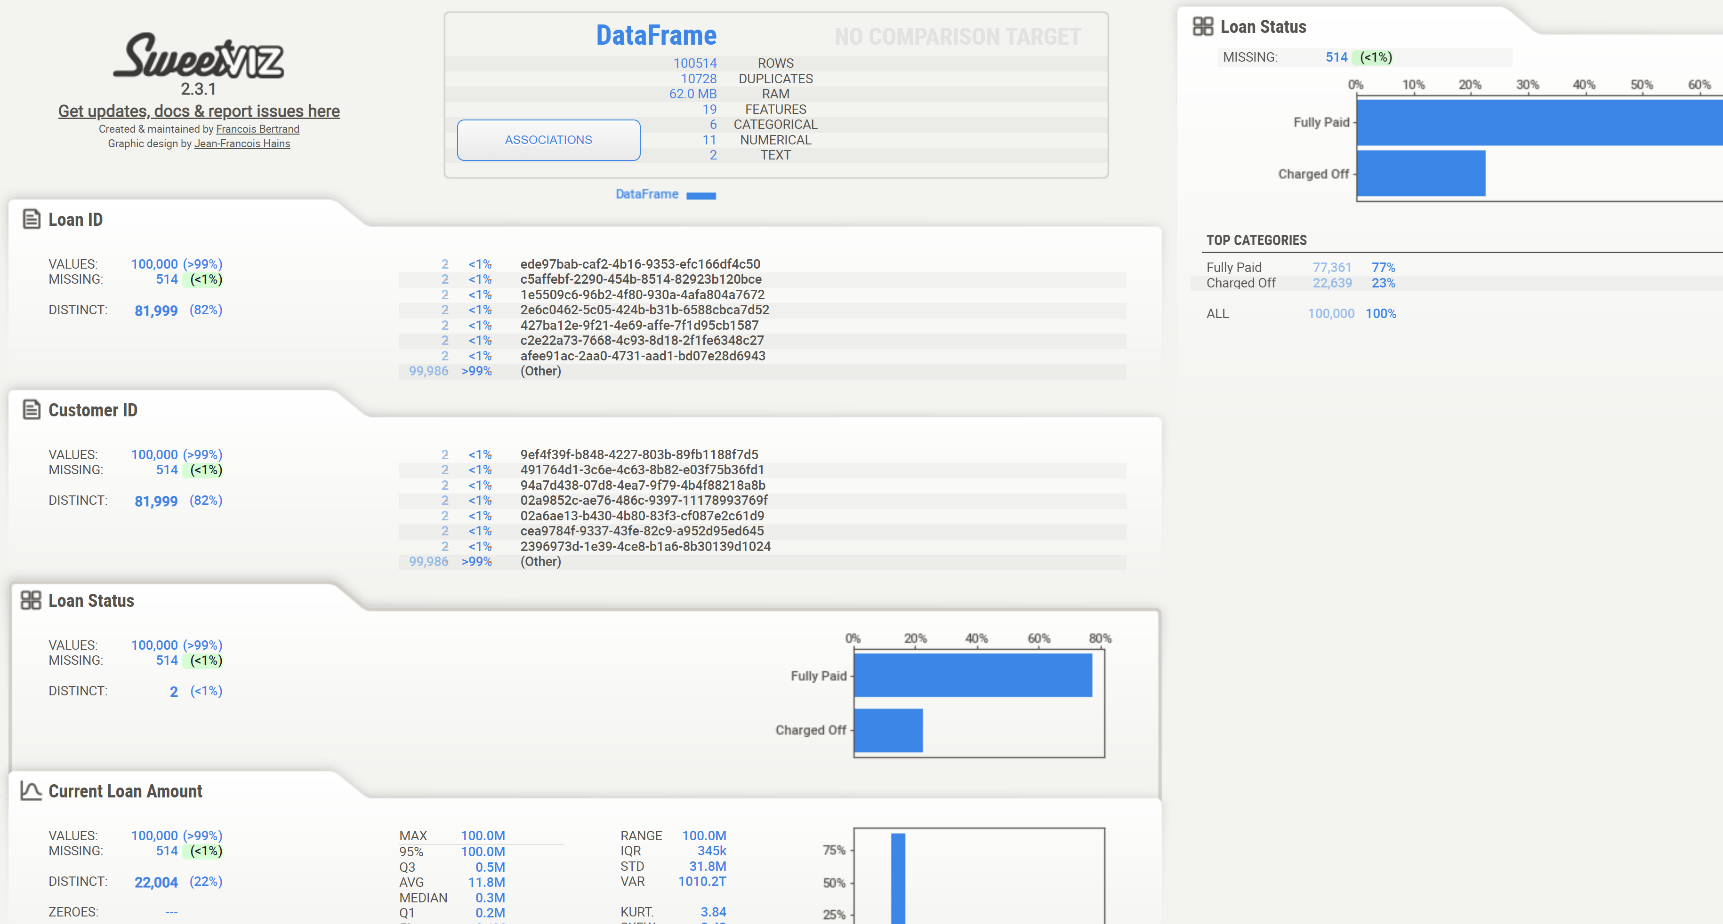
Data Profiling
Combination of Manual and Automated Profiling:
I used a combination of manual profiling using Pandas and automated profiling with the Sweetviz library in Python.
Insights from Profiling:
Both methods provided valuable insights into the structure, distribution, and patterns within the overall dataset.
Attached Report:
The attached credit_data_sweetviz_report.html file in the email, offers a detailed visual analysis of the data.

Slide 3
Data Pipeline Process
Overview of the Data Pipeline and Tools:
Environment: Docker Desktop was used to run Airflow and PostgreSQL, with PostgreSQL serving as the database.
ETL Process: The attached Python code performs Extraction, Transformation, and Loading (ETL) of the data into PostgreSQL. The process is orchestrated and executed within Airflow.
Key Functions:
Extract Data: Currently, the extraction is a basic function where data is read from a CSV file. However, it is designed to be scalable for additional data sources in the future.
Transform Data: After data profiling, the data is cleaned and prepared for better readability and integration into the database.
Load Data: Data is loaded into three separate tables – Customer, Loan, and Credit History. Each table is handled by its own function, allowing for parallel execution if needed.
Error Handling and Logging: Robust error handling mechanisms are in place, with detailed logging to capture and track issues during data extraction, transformation, and loading processes. This ensures transparency and enables quick troubleshooting in case of failures or unexpected behavior.
Quality Checks: Basic quality checks have been implemented, including checks for null values in unique IDs, duplicate records, and other data integrity issues. Additional checks can be added as needed to enhance data validation and consistency.

Slide 4
Data Model and Table Structure Overview
There main tables are created from the given Credit data: customer, Loan and credit_history tables
Column Name | Data Type
customer_id | VARCHAR(50) Primary Key
years_in_current_job | VARCHAR(15)
home_ownership | VARCHAR(20)
annual_income | NUMERIC
customer
credit_history
Column Name | Data Type & Constraints
loan_id | VARCHAR(50) Primary Key, Foreign Key (references loan.loan_id)
credit_score | NUMERIC
monthly_debt | NUMERIC
years_of_credit_history | NUMERIC
months_since_last_delinquent | NUMERIC
number_of_open_accounts | NUMERIC
number_of_credit_problems | NUMERIC
current_credit_balance | NUMERIC
maximum_open_credit | NUMERIC
bankruptcies | NUMERIC
tax_liens | NUMERIC
Column Name | Data Type & Constraints
loan_id | VARCHAR(50) Primary Key
customer_id | VARCHAR(50) Foreign Key (references customer.customer_id)
loan_status | VARCHAR(15)
current_loan_amount | NUMERIC
term | VARCHAR(15)
purpose | VARCHAR(25)
loan

Slide 5
Data Model and Table Structure Overview
Reasons for Organizing Data into Customer, Loan, and Credit History Tables
Avoid Redundancy: Customer data, loan data, and credit history data are different types of information, so keeping them in separate tables prevents repeating the same data (like customer details) for each loan.
Logical Grouping: Customer information is relatively static, loans vary over time, and credit history is detailed for each loan. By splitting them, you can manage each type of data more easily and make future updates without affecting other data.
Relationships reasoning
One-to-Many (Customer to Loan): A customer can have multiple loans, so it’s good to have separate loan table linked to the customer table via a foreign key.
One-to-One (Loan to Credit History): Each loan has a unique credit history record, so each loan entry links to one credit history record using a foreign key.

Slide 6
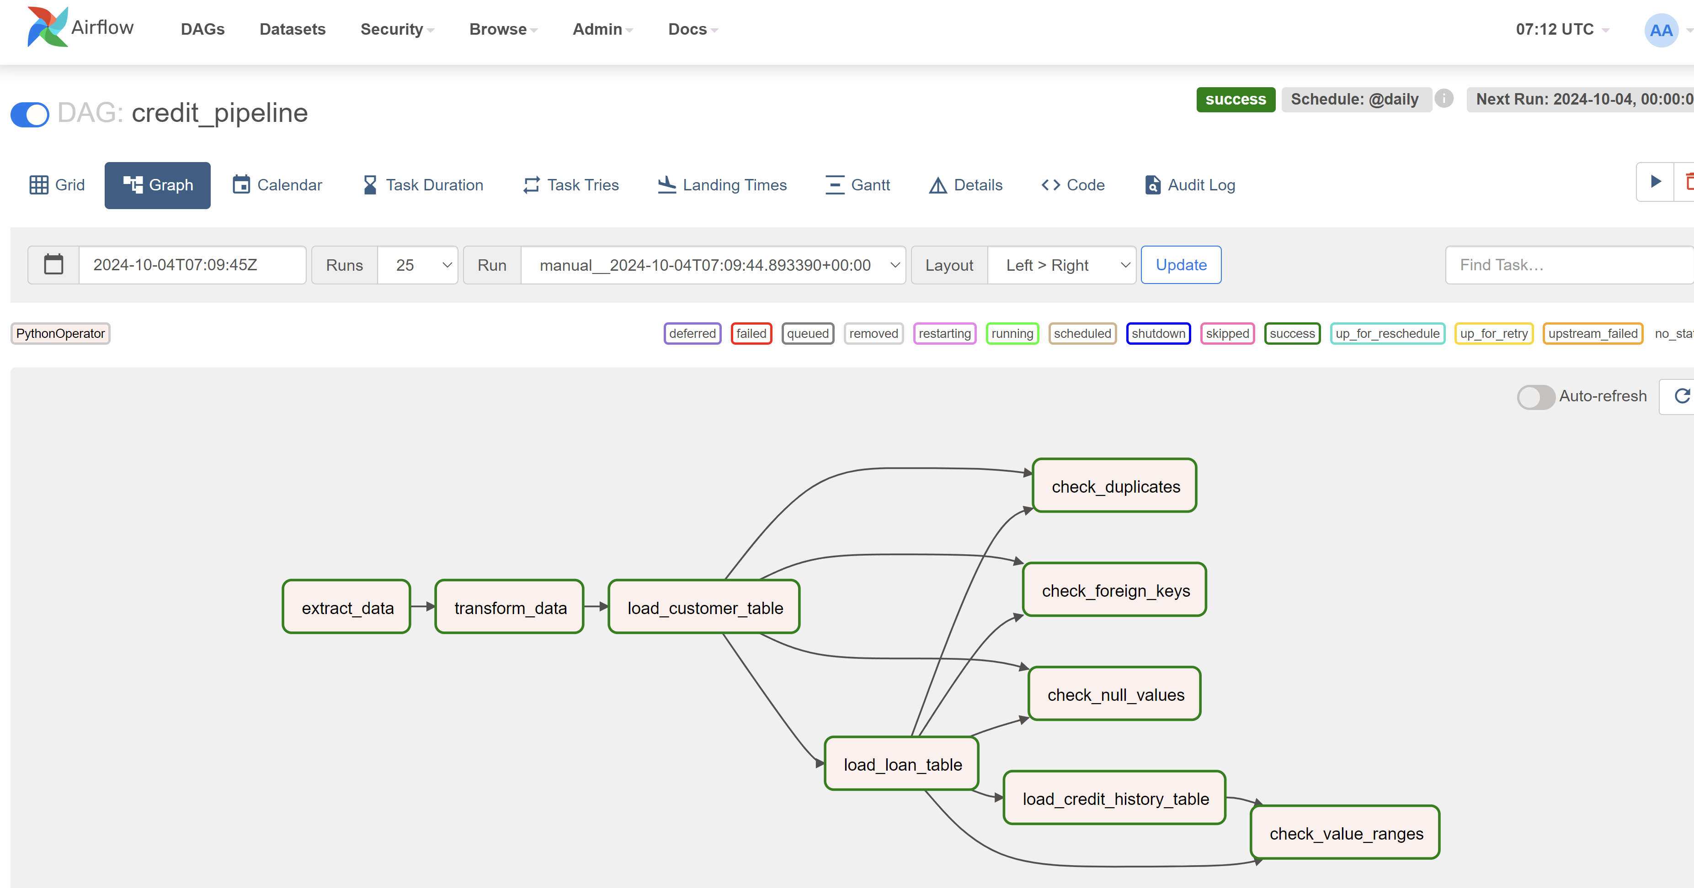
Airflow DAG

Slide 7
